Slide 1
Filtering Continued
Scott Spurlock
2/22/16
Many slides adapted from Andrew Adams, Steve Seitz, Richard Souvenir

Slide 2
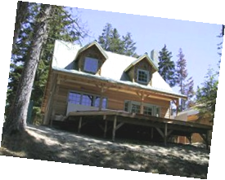
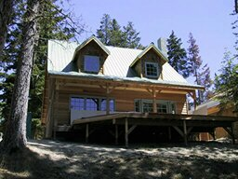
Image Transformations
Warping: change the domain
Filtering: change the range
translation
rotation
scaling

Slide 3
Filtering
Previously: point operations

Slide 4
Filtering
Previously: point operations
Today: neighborhood operations

Slide 5
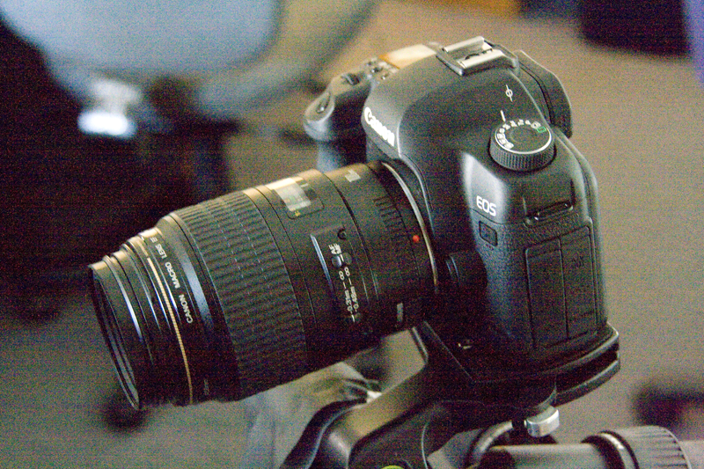
Application: Denoising

Slide 6
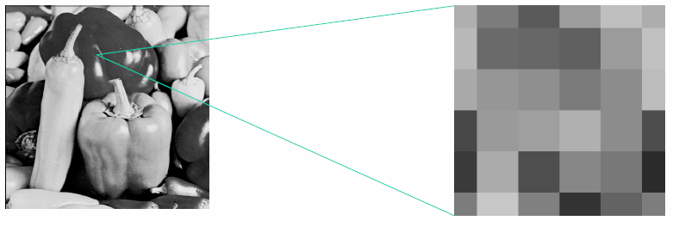
Imaging Noise
Cameras are not perfect sensors
Scenes are not represented in the way you might expect

Slide 7
How do we identify a noisy pixel?
It’s not like its neighbors
Solution?
0 | 0 | 0 | 0 | 0 | 0 | 0 | 0 | 0 | 0
0 | 0 | 0 | 0 | 0 | 0 | 0 | 0 | 0 | 0
0 | 0 | 0 | 90 | 90 | 90 | 90 | 90 | 0 | 0
0 | 0 | 0 | 90 | 90 | 90 | 90 | 90 | 0 | 0
0 | 0 | 0 | 90 | 90 | 90 | 90 | 90 | 0 | 0
0 | 0 | 0 | 90 | 0 | 90 | 90 | 90 | 0 | 0
0 | 0 | 0 | 90 | 90 | 90 | 90 | 90 | 0 | 0
0 | 0 | 0 | 0 | 0 | 0 | 0 | 0 | 0 | 0
0 | 0 | 90 | 0 | 0 | 0 | 0 | 0 | 0 | 0
0 | 0 | 0 | 0 | 0 | 0 | 0 | 0 | 0 | 0

Slide 8
How do we identify a noisy pixel?
It’s not like its neighbors
Solution?
Replace each pixel with the average of its neighbors
0 | 0 | 0 | 0 | 0 | 0 | 0 | 0 | 0 | 0
0 | 0 | 0 | 0 | 0 | 0 | 0 | 0 | 0 | 0
0 | 0 | 0 | 90 | 90 | 90 | 90 | 90 | 0 | 0
0 | 0 | 0 | 90 | 90 | 90 | 90 | 90 | 0 | 0
0 | 0 | 0 | 90 | 90 | 90 | 90 | 90 | 0 | 0
0 | 0 | 0 | 90 | 0 | 90 | 90 | 90 | 0 | 0
0 | 0 | 0 | 90 | 90 | 90 | 90 | 90 | 0 | 0
0 | 0 | 0 | 0 | 0 | 0 | 0 | 0 | 0 | 0
0 | 0 | 90 | 0 | 0 | 0 | 0 | 0 | 0 | 0
0 | 0 | 0 | 0 | 0 | 0 | 0 | 0 | 0 | 0

Slide 9

Blurring an image
Replace each pixel with the average of its neighbors
Use a kernel to determine which neighbors to include
This type of kernel is often called a box filter
cv2.blur(image, (3, 3))
1
1
1
1
1
1
1
1
1

Slide 10
Image filtering
1
1
1
1
1
1
1
1
1
0 | 0 | 0 | 0 | 0 | 0 | 0 | 0 | 0 | 0
0 | 0 | 0 | 0 | 0 | 0 | 0 | 0 | 0 | 0
0 | 0 | 0 | 90 | 90 | 90 | 90 | 90 | 0 | 0
0 | 0 | 0 | 90 | 90 | 90 | 90 | 90 | 0 | 0
0 | 0 | 0 | 90 | 90 | 90 | 90 | 90 | 0 | 0
0 | 0 | 0 | 90 | 0 | 90 | 90 | 90 | 0 | 0
0 | 0 | 0 | 90 | 90 | 90 | 90 | 90 | 0 | 0
0 | 0 | 0 | 0 | 0 | 0 | 0 | 0 | 0 | 0
0 | 0 | 90 | 0 | 0 | 0 | 0 | 0 | 0 | 0
0 | 0 | 0 | 0 | 0 | 0 | 0 | 0 | 0 | 0
 | 0
0 | 0 | 0 | 0 | 0 | 0 | 0 | 0 | 0 | 0
0 | 0 | 0 | 0 | 0 | 0 | 0 | 0 | 0 | 0
0 | 0 | 0 | 90 | 90 | 90 | 90 | 90 | 0 | 0
0 | 0 | 0 | 90 | 90 | 90 | 90 | 90 | 0 | 0
0 | 0 | 0 | 90 | 90 | 90 | 90 | 90 | 0 | 0
0 | 0 | 0 | 90 | 0 | 90 | 90 | 90 | 0 | 0
0 | 0 | 0 | 90 | 90 | 90 | 90 | 90 | 0 | 0
0 | 0 | 0 | 0 | 0 | 0 | 0 | 0 | 0 | 0
0 | 0 | 90 | 0 | 0 | 0 | 0 | 0 | 0 | 0
0 | 0 | 0 | 0 | 0 | 0 | 0 | 0 | 0 | 0
Credit: S. Seitz
Notes:
ones, divide by 9

Slide 11
Image filtering
1
1
1
1
1
1
1
1
1
0 | 0 | 0 | 0 | 0 | 0 | 0 | 0 | 0 | 0
0 | 0 | 0 | 0 | 0 | 0 | 0 | 0 | 0 | 0
0 | 0 | 0 | 90 | 90 | 90 | 90 | 90 | 0 | 0
0 | 0 | 0 | 90 | 90 | 90 | 90 | 90 | 0 | 0
0 | 0 | 0 | 90 | 90 | 90 | 90 | 90 | 0 | 0
0 | 0 | 0 | 90 | 0 | 90 | 90 | 90 | 0 | 0
0 | 0 | 0 | 90 | 90 | 90 | 90 | 90 | 0 | 0
0 | 0 | 0 | 0 | 0 | 0 | 0 | 0 | 0 | 0
0 | 0 | 90 | 0 | 0 | 0 | 0 | 0 | 0 | 0
0 | 0 | 0 | 0 | 0 | 0 | 0 | 0 | 0 | 0
 | 0 | 10
0 | 0 | 0 | 0 | 0 | 0 | 0 | 0 | 0 | 0
0 | 0 | 0 | 0 | 0 | 0 | 0 | 0 | 0 | 0
0 | 0 | 0 | 90 | 90 | 90 | 90 | 90 | 0 | 0
0 | 0 | 0 | 90 | 90 | 90 | 90 | 90 | 0 | 0
0 | 0 | 0 | 90 | 90 | 90 | 90 | 90 | 0 | 0
0 | 0 | 0 | 90 | 0 | 90 | 90 | 90 | 0 | 0
0 | 0 | 0 | 90 | 90 | 90 | 90 | 90 | 0 | 0
0 | 0 | 0 | 0 | 0 | 0 | 0 | 0 | 0 | 0
0 | 0 | 90 | 0 | 0 | 0 | 0 | 0 | 0 | 0
0 | 0 | 0 | 0 | 0 | 0 | 0 | 0 | 0 | 0
Credit: S. Seitz
Notes:
ones, divide by 9

Slide 12
Image filtering
1
1
1
1
1
1
1
1
1
0 | 0 | 0 | 0 | 0 | 0 | 0 | 0 | 0 | 0
0 | 0 | 0 | 0 | 0 | 0 | 0 | 0 | 0 | 0
0 | 0 | 0 | 90 | 90 | 90 | 90 | 90 | 0 | 0
0 | 0 | 0 | 90 | 90 | 90 | 90 | 90 | 0 | 0
0 | 0 | 0 | 90 | 90 | 90 | 90 | 90 | 0 | 0
0 | 0 | 0 | 90 | 0 | 90 | 90 | 90 | 0 | 0
0 | 0 | 0 | 90 | 90 | 90 | 90 | 90 | 0 | 0
0 | 0 | 0 | 0 | 0 | 0 | 0 | 0 | 0 | 0
0 | 0 | 90 | 0 | 0 | 0 | 0 | 0 | 0 | 0
0 | 0 | 0 | 0 | 0 | 0 | 0 | 0 | 0 | 0
 | 0 | 10 | 20
0 | 0 | 0 | 0 | 0 | 0 | 0 | 0 | 0 | 0
0 | 0 | 0 | 0 | 0 | 0 | 0 | 0 | 0 | 0
0 | 0 | 0 | 90 | 90 | 90 | 90 | 90 | 0 | 0
0 | 0 | 0 | 90 | 90 | 90 | 90 | 90 | 0 | 0
0 | 0 | 0 | 90 | 90 | 90 | 90 | 90 | 0 | 0
0 | 0 | 0 | 90 | 0 | 90 | 90 | 90 | 0 | 0
0 | 0 | 0 | 90 | 90 | 90 | 90 | 90 | 0 | 0
0 | 0 | 0 | 0 | 0 | 0 | 0 | 0 | 0 | 0
0 | 0 | 90 | 0 | 0 | 0 | 0 | 0 | 0 | 0
0 | 0 | 0 | 0 | 0 | 0 | 0 | 0 | 0 | 0
Credit: S. Seitz
Notes:
ones, divide by 9

Slide 13
Image filtering
1
1
1
1
1
1
1
1
1
0 | 0 | 0 | 0 | 0 | 0 | 0 | 0 | 0 | 0
0 | 0 | 0 | 0 | 0 | 0 | 0 | 0 | 0 | 0
0 | 0 | 0 | 90 | 90 | 90 | 90 | 90 | 0 | 0
0 | 0 | 0 | 90 | 90 | 90 | 90 | 90 | 0 | 0
0 | 0 | 0 | 90 | 90 | 90 | 90 | 90 | 0 | 0
0 | 0 | 0 | 90 | 0 | 90 | 90 | 90 | 0 | 0
0 | 0 | 0 | 90 | 90 | 90 | 90 | 90 | 0 | 0
0 | 0 | 0 | 0 | 0 | 0 | 0 | 0 | 0 | 0
0 | 0 | 90 | 0 | 0 | 0 | 0 | 0 | 0 | 0
0 | 0 | 0 | 0 | 0 | 0 | 0 | 0 | 0 | 0
 | 0 | 10 | 20 | 30
0 | 0 | 0 | 0 | 0 | 0 | 0 | 0 | 0 | 0
0 | 0 | 0 | 0 | 0 | 0 | 0 | 0 | 0 | 0
0 | 0 | 0 | 90 | 90 | 90 | 90 | 90 | 0 | 0
0 | 0 | 0 | 90 | 90 | 90 | 90 | 90 | 0 | 0
0 | 0 | 0 | 90 | 90 | 90 | 90 | 90 | 0 | 0
0 | 0 | 0 | 90 | 0 | 90 | 90 | 90 | 0 | 0
0 | 0 | 0 | 90 | 90 | 90 | 90 | 90 | 0 | 0
0 | 0 | 0 | 0 | 0 | 0 | 0 | 0 | 0 | 0
0 | 0 | 90 | 0 | 0 | 0 | 0 | 0 | 0 | 0
0 | 0 | 0 | 0 | 0 | 0 | 0 | 0 | 0 | 0
Credit: S. Seitz
Notes:
ones, divide by 9

Slide 14
Image filtering
1
1
1
1
1
1
1
1
1
0 | 0 | 0 | 0 | 0 | 0 | 0 | 0 | 0 | 0
0 | 0 | 0 | 0 | 0 | 0 | 0 | 0 | 0 | 0
0 | 0 | 0 | 90 | 90 | 90 | 90 | 90 | 0 | 0
0 | 0 | 0 | 90 | 90 | 90 | 90 | 90 | 0 | 0
0 | 0 | 0 | 90 | 90 | 90 | 90 | 90 | 0 | 0
0 | 0 | 0 | 90 | 0 | 90 | 90 | 90 | 0 | 0
0 | 0 | 0 | 90 | 90 | 90 | 90 | 90 | 0 | 0
0 | 0 | 0 | 0 | 0 | 0 | 0 | 0 | 0 | 0
0 | 0 | 90 | 0 | 0 | 0 | 0 | 0 | 0 | 0
0 | 0 | 0 | 0 | 0 | 0 | 0 | 0 | 0 | 0
 | 0 | 10 | 20 | 30 | 30
Credit: S. Seitz
Notes:
ones, divide by 9

Slide 15
Image filtering
1
1
1
1
1
1
1
1
1
0 | 0 | 0 | 0 | 0 | 0 | 0 | 0 | 0 | 0
0 | 0 | 0 | 0 | 0 | 0 | 0 | 0 | 0 | 0
0 | 0 | 0 | 90 | 90 | 90 | 90 | 90 | 0 | 0
0 | 0 | 0 | 90 | 90 | 90 | 90 | 90 | 0 | 0
0 | 0 | 0 | 90 | 90 | 90 | 90 | 90 | 0 | 0
0 | 0 | 0 | 90 | 0 | 90 | 90 | 90 | 0 | 0
0 | 0 | 0 | 90 | 90 | 90 | 90 | 90 | 0 | 0
0 | 0 | 0 | 0 | 0 | 0 | 0 | 0 | 0 | 0
0 | 0 | 90 | 0 | 0 | 0 | 0 | 0 | 0 | 0
0 | 0 | 0 | 0 | 0 | 0 | 0 | 0 | 0 | 0
 | 0 | 10 | 20 | 30 | 30
?
Credit: S. Seitz
Notes:
ones, divide by 9

Slide 16
Image filtering
1
1
1
1
1
1
1
1
1
0 | 0 | 0 | 0 | 0 | 0 | 0 | 0 | 0 | 0
0 | 0 | 0 | 0 | 0 | 0 | 0 | 0 | 0 | 0
0 | 0 | 0 | 90 | 90 | 90 | 90 | 90 | 0 | 0
0 | 0 | 0 | 90 | 90 | 90 | 90 | 90 | 0 | 0
0 | 0 | 0 | 90 | 90 | 90 | 90 | 90 | 0 | 0
0 | 0 | 0 | 90 | 0 | 90 | 90 | 90 | 0 | 0
0 | 0 | 0 | 90 | 90 | 90 | 90 | 90 | 0 | 0
0 | 0 | 0 | 0 | 0 | 0 | 0 | 0 | 0 | 0
0 | 0 | 90 | 0 | 0 | 0 | 0 | 0 | 0 | 0
0 | 0 | 0 | 0 | 0 | 0 | 0 | 0 | 0 | 0
 | 0 | 10 | 20 | 30 | 30
 |  |  |  | 50
?
Credit: S. Seitz
Notes:
ones, divide by 9

Slide 17
Image filtering
1
1
1
1
1
1
1
1
1
0 | 0 | 0 | 0 | 0 | 0 | 0 | 0 | 0 | 0
0 | 0 | 0 | 0 | 0 | 0 | 0 | 0 | 0 | 0
0 | 0 | 0 | 90 | 90 | 90 | 90 | 90 | 0 | 0
0 | 0 | 0 | 90 | 90 | 90 | 90 | 90 | 0 | 0
0 | 0 | 0 | 90 | 90 | 90 | 90 | 90 | 0 | 0
0 | 0 | 0 | 90 | 0 | 90 | 90 | 90 | 0 | 0
0 | 0 | 0 | 90 | 90 | 90 | 90 | 90 | 0 | 0
0 | 0 | 0 | 0 | 0 | 0 | 0 | 0 | 0 | 0
0 | 0 | 90 | 0 | 0 | 0 | 0 | 0 | 0 | 0
0 | 0 | 0 | 0 | 0 | 0 | 0 | 0 | 0 | 0
 | 0 | 10 | 20 | 30 | 30 | 30 | 20 | 10
 | 0 | 20 | 40 | 60 | 60 | 60 | 40 | 20
 | 0 | 30 | 60 | 90 | 90 | 90 | 60 | 30
 | 0 | 30 | 50 | 80 | 80 | 90 | 60 | 30
 | 0 | 30 | 50 | 80 | 80 | 90 | 60 | 30
 | 0 | 20 | 30 | 50 | 50 | 60 | 40 | 20
 | 10 | 20 | 30 | 30 | 30 | 30 | 20 | 10
 | 10 | 10 | 10 | 0 | 0 | 0 | 0 | 0
Credit: S. Seitz

Slide 18

Visual Shorthand
We can visualize a kernel as an image
Highest values are white
Lowest values are black
Pad with extra zeros for ease of viewing
1
1
1
1
1
1
1
1
1
Box filter

Slide 19
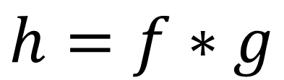
Filtering by any other name
Linear filtering
Technically, this is known as correlation
But in practice is often called convolution
$$h=f∗g$$

Slide 20
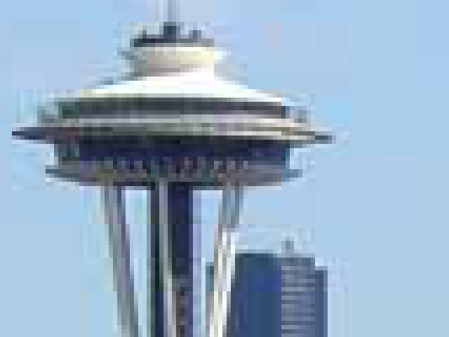
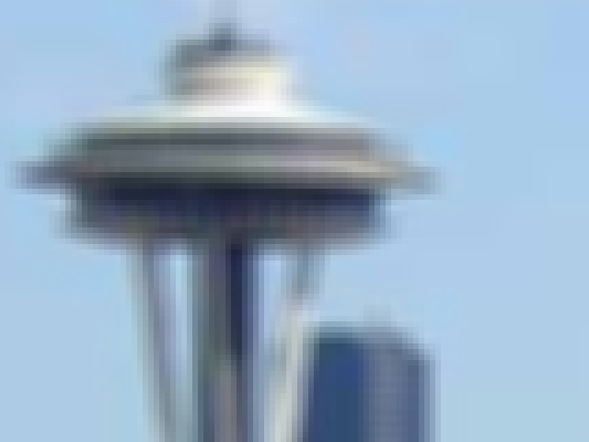
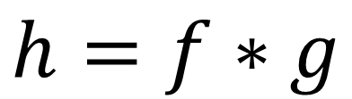
Filtering by any other name
$$h=f∗g$$
=
*
Kernel g
Input image f
Output image h

Slide 21
Before:

Slide 22

3x3 Box Filter

Slide 23

5x5 Box Filter

Slide 24
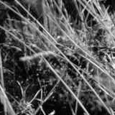
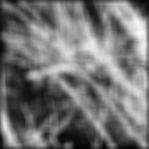
Blurring with a box filter
Notes:
Here is the point to introduce some visual “notation”. I’ve given the kernel as an image on the top.
Usually, these images are white for the largest value, and black for the smallest (which is zero in
this case). The point of this pair of images is that if you convolve the one on the left with the kernel
shown above you get the one on the right, which is nothing like a smoothed version of the one on
the left (there’s some fairly aggressive ringing). Explain the ringing qualitatively in terms of the
boundaries of the kernel, and point out that the effect would disappear if there weren’t sharp edges
in the kernel.

Slide 25
What does real blur look like?
Imagine a point of light
What does the point look like when viewed through an unfocused lens?
Can we make a filter to blur like this?

Slide 26
What does real blur look like?
Imagine a point of light
What does the point look like when viewed through an unfocused lens?
Can we make a filter to blur like this?
cv2.GaussianBlur(image, (13, 13), 0)

Slide 27
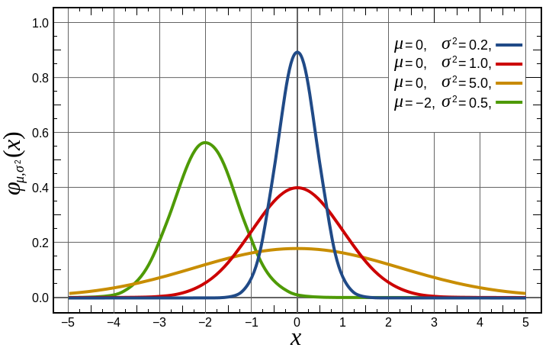
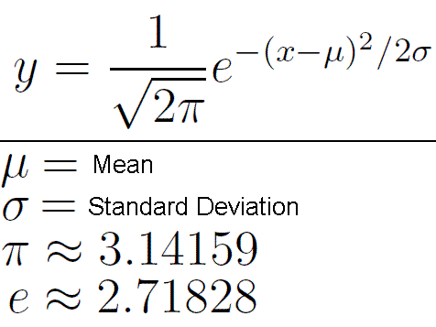
Math Interlude: Gaussian Distribution
AKA Normal/bell curve
https://en.wikipedia.org/wiki/Normal_distribution

Slide 28
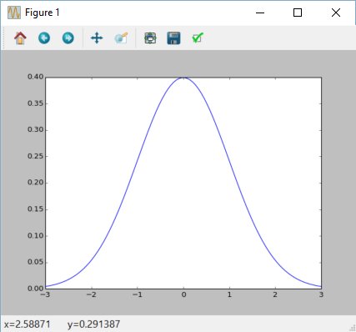
Math Interlude: Gaussian Distribution
AKA Normal/bell curve
We could represent a Gaussian like this as a 1D array
array([ 0.00443185, 0.00530579, 0.00632878, 0.00752133, 0.00890582, …

Slide 29
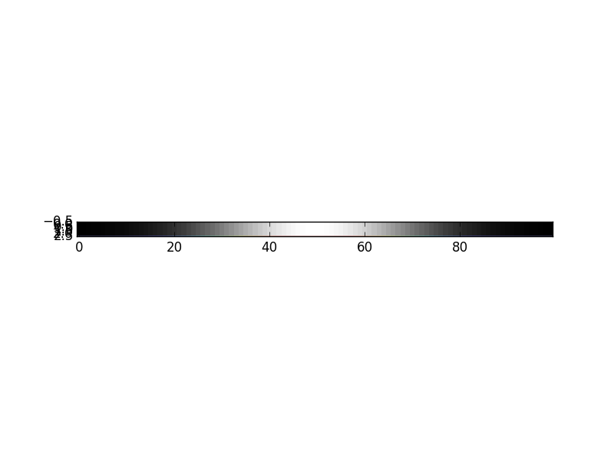
Math Interlude: Gaussian Distribution
AKA Normal/bell curve
We could represent a Gaussian like this as a 1D array
We could visualize this as a grayscale image
array([ 0.00443185, 0.00530579, 0.00632878, 0.00752133, 0.00890582, …

Slide 30
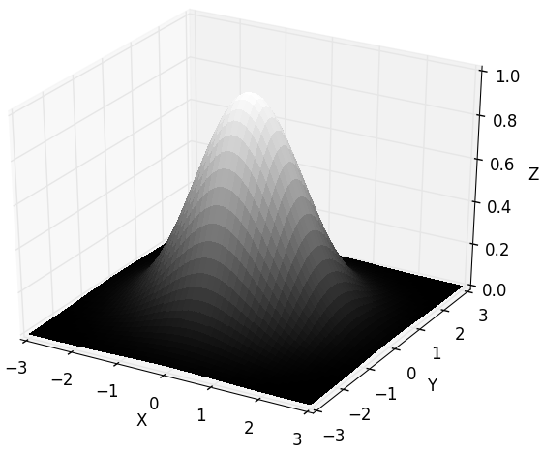
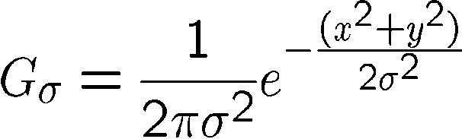
Math Interlude: Gaussian Distribution
Gaussian distributions can be 2D

Slide 31
Math Interlude: Gaussian Distribution
Gaussian distributions can be 2D
We could represent a Gaussian like this as a 2D array
array([[ 6.26443576e-07, 1.08773899e-06, 1.82266398e-06, ...,
1.82266398e-06, 1.08773899e-06, 6.26443576e-07],
[ 1.08773899e-06, 1.88871936e-06, 3.16482243e-06, ...,
3.16482243e-06, 1.88871936e-06, 1.08773899e-06],
[ 1.82266398e-06, 3.16482243e-06, 5.30311766e-06, ...,
5.30311766e-06, 3.16482243e-06, 1.82266398e-06],
...,
[ 1.82266398e-06, 3.16482243e-06, 5.30311766e-06, ...,
5.30311766e-06, 3.16482243e-06, 1.82266398e-06],
[ 1.08773899e-06, 1.88871936e-06, 3.16482243e-06, ...,
3.16482243e-06, 1.88871936e-06, 1.08773899e-06],
[ 6.26443576e-07, 1.08773899e-06, 1.82266398e-06, ...,
1.82266398e-06, 1.08773899e-06, 6.26443576e-07]])

Slide 32
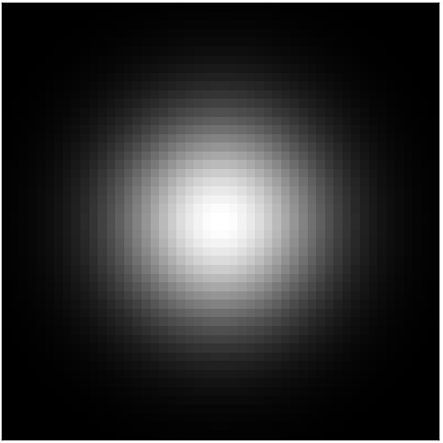
Math Interlude: Gaussian Distribution
Gaussian distributions can be 2D
We could represent a Gaussian like this as a 2D array
We could visualize the array as a grayscale image
array([[ 6.26443576e-07, 1.08773899e-06, 1.82266398e-06, ...,

Slide 33
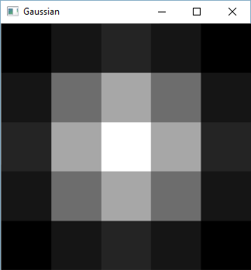
Important filter: Gaussian
Weight contributions of neighboring pixels by nearness
0.003 0.013 0.022 0.013 0.003
0.013 0.059 0.097 0.059 0.013
0.022 0.097 0.159 0.097 0.022
0.013 0.059 0.097 0.059 0.013
0.003 0.013 0.022 0.013 0.003
5 x 5, σ = 1

Slide 34
Box Filter vs Gaussian Filter
1
1
1
0.0625
0.125
0.0625
1
1
1
0.125
0.25
0.125
1
1
1
0.0625
0.125
0.0625
Box filter:
Normal average
Gaussian filter:
Weighted average

Slide 35
Image filtering – Gaussian kernel
0.0625
0.125
0.0625
0.125
0.25
0.125
0.0625
0.125
0.0625
0 | 0 | 0 | 0 | 0 | 0 | 0 | 0 | 0 | 0
0 | 0 | 0 | 0 | 0 | 0 | 0 | 0 | 0 | 0
0 | 0 | 0 | 90 | 90 | 90 | 90 | 90 | 0 | 0
0 | 0 | 0 | 90 | 90 | 90 | 90 | 90 | 0 | 0
0 | 0 | 0 | 90 | 90 | 90 | 90 | 90 | 0 | 0
0 | 0 | 0 | 90 | 0 | 90 | 90 | 90 | 0 | 0
0 | 0 | 0 | 90 | 90 | 90 | 90 | 90 | 0 | 0
0 | 0 | 0 | 0 | 0 | 0 | 0 | 0 | 0 | 0
0 | 0 | 90 | 0 | 0 | 0 | 0 | 0 | 0 | 0
0 | 0 | 0 | 0 | 0 | 0 | 0 | 0 | 0 | 0
?
Notes:
ones, divide by 9

Slide 36
Image filtering – Gaussian kernel
0.0625
0.125
0.0625
0.125
0.25
0.125
0.0625
0.125
0.0625
0 | 0 | 0 | 0 | 0 | 0 | 0 | 0 | 0 | 0
0 | 0 | 0 | 0 | 0 | 0 | 0 | 0 | 0 | 0
0 | 0 | 0 | 90 | 90 | 90 | 90 | 90 | 0 | 0
0 | 0 | 0 | 90 | 90 | 90 | 90 | 90 | 0 | 0
0 | 0 | 0 | 90 | 90 | 90 | 90 | 90 | 0 | 0
0 | 0 | 0 | 90 | 0 | 90 | 90 | 90 | 0 | 0
0 | 0 | 0 | 90 | 90 | 90 | 90 | 90 | 0 | 0
0 | 0 | 0 | 0 | 0 | 0 | 0 | 0 | 0 | 0
0 | 0 | 90 | 0 | 0 | 0 | 0 | 0 | 0 | 0
0 | 0 | 0 | 0 | 0 | 0 | 0 | 0 | 0 | 0
(0.0625 x 90) + (0.125 x 0) + (0.0625 x 90)
+ (0.125 x 90) + (0.25 x 90) + (0.125 x 90)
+ (0.0625 x 0) + (0.125 x 0) + (0.0625 x 0)
?
Notes:
ones, divide by 9

Slide 37
Image filtering – Gaussian kernel
0.0625
0.125
0.0625
0.125
0.25
0.125
0.0625
0.125
0.0625
0 | 0 | 0 | 0 | 0 | 0 | 0 | 0 | 0 | 0
0 | 0 | 0 | 0 | 0 | 0 | 0 | 0 | 0 | 0
0 | 0 | 0 | 90 | 90 | 90 | 90 | 90 | 0 | 0
0 | 0 | 0 | 90 | 90 | 90 | 90 | 90 | 0 | 0
0 | 0 | 0 | 90 | 90 | 90 | 90 | 90 | 0 | 0
0 | 0 | 0 | 90 | 0 | 90 | 90 | 90 | 0 | 0
0 | 0 | 0 | 90 | 90 | 90 | 90 | 90 | 0 | 0
0 | 0 | 0 | 0 | 0 | 0 | 0 | 0 | 0 | 0
0 | 0 | 90 | 0 | 0 | 0 | 0 | 0 | 0 | 0
0 | 0 | 0 | 0 | 0 | 0 | 0 | 0 | 0 | 0
56
Notes:
ones, divide by 9

Slide 38
Smoothing with box filter

Slide 39

Smoothing with Gaussian filter

Slide 40
Practical matters
How big should the filter be?
The bigger the filter, the stronger the blur
How big should σ be?
Set σ to about filter size/6
Let OpenCV handle it
cv2.GaussianBlur(image, (13, 13), 0)

Slide 41
Before:

Slide 42

13 x 13 Gaussian blur

Slide 43

31 x 31 Gaussian blur

Slide 44
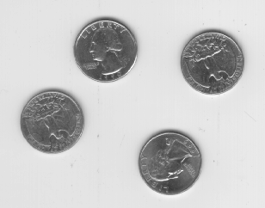
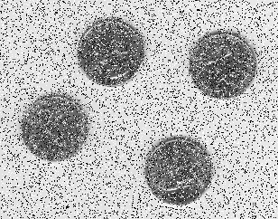

Median Filters
Replace each pixel with the median of its neighbors
original
noisy
median filtered 5x5 window

Slide 45
Median Filters
Replace each pixel with the median of its neighbors
cv2.medianBlur(image, 5)
original
noisy
median filtered 5x5 window

Slide 46
Median Filters
Replace each pixel with the median of its neighbors
99
98
250
Mean = 133
100
101
99
Weighted Mean = 128
Median = ?
105
250
97

Slide 47
Median Filters
Replace each pixel with the median of its neighbors
99
98
250
Mean = 133
100
101
99
Weighted Mean = 128
Median = 100
105
250
97

Slide 48
Median Filters
Replace each pixel with the median of its neighbors
Removes small details
Not linear filtering / convolution (why not?)
original
noisy
median filtered 5x5 window

Slide 49
Before:

Slide 50
Gaussian Blur:

Slide 51

After Median Filter:

Slide 52
Idea so far
Averaging
Each pixel should look like its neighbors
Average all the pixels in the neighborhood
Mean, weighted mean, median
New idea: bilateral
Each pixel should look like SOME of its neighbors
Only average similar looking neighbors

Slide 53


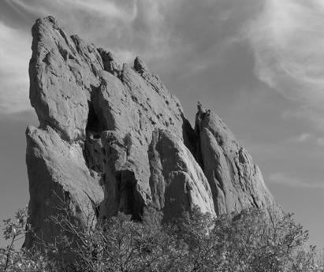
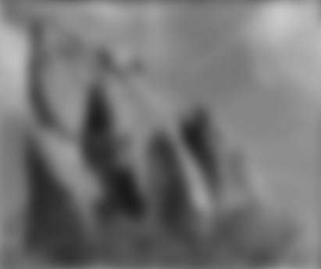


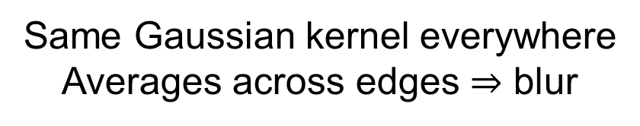
Gaussian Smoothing
*
input
output
*
*
Same Gaussian kernel everywhere
Averages across edges $⇒$ blur
Slide credit Sylvain Paris, Siggraph 2007

Slide 54

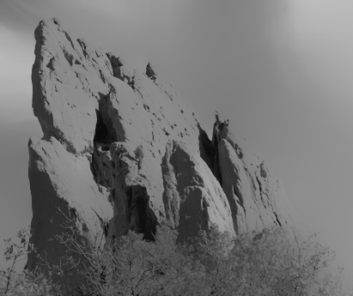


Bilateral Filtering
*
input
output
*
*
Kernel shape depends on image content
Avoids averaging across edges
Slide credit Sylvain Paris, Siggraph 2007

Slide 55
Bilateral Filtering
*
cv2.bilateralFilter(image, 9, 41, 41)
input
output
*
Neighborhood
Size
*
Color σ
Spatial σ
Kernel shape depends on image content
Avoids averaging across edges
Slide credit Sylvain Paris, Siggraph 2007

Slide 56
Before:

Slide 57
Gaussian Blur:

Slide 58
After Median Filter:

Slide 59

After Bilateral:

Slide 60
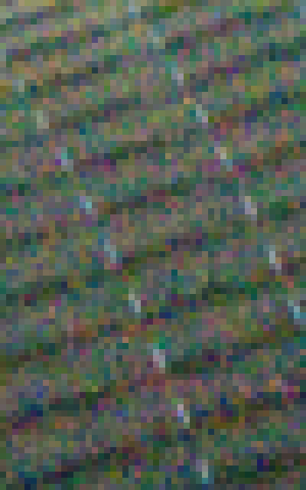
Leveraging Similarity: Non-Local Means

Slide 61
What color should this pixel be?

Slide 62

What color should this pixel be?

Slide 63
Gaussian Blur:
A weighted average of these:
(all nearby pixels)

Slide 64
Bilateral filter
A weighted average of these:
(the nearby ones that have a similar color to me)

Slide 65
Non-Local Means
A weighted average of these:
(the ones that have similar neighbors to me)

Slide 66
Non-Local Means:
For each pixel
Find every other (nearby) pixel that has a similar local neighborhood around it to me
Set my value to be the weighted average of those
img_nld = image.copy()
img_nld = cv2.fastNlMeansDenoisingColored(image, img_nld, 11, 11, 11, 31)
Input image
Brightness filter strength
Color filter strength
Window sizes
Output image

Slide 67
Before:

Slide 68
Gaussian Blur:

Slide 69
After Median Filter:

Slide 70
After Bilateral:

Slide 71

After Non-Local Means:

Slide 72
Before:

Slide 73
Denoising Method Comparison
Method | Linear | Speed | Effectiveness | OpenCV Method
Box | Yes |  | ? | cv2.blur
Gaussian | Yes |  | ? | cv2.GaussianBlur
Median | No |  | ? | cv2.medianBlur
Bi-lateral | No |  | ? | cv2.bilateralFilter
Non-local Means | No |  | ? | cv2.fastNlMeansDenoisingColored
Speed: greatly depends on parameters (especially neighborhood size)
Effectiveness: greatly depends on problem
Practical advice: always start with Gaussian

Slide 74
Practical Matters
Gaussian blur is a common preprocessing step
Speed requirements may dictate options
For color, filter each channel separately
OpenCV handles this
For borders, there are several options
OpenCV handles this

Slide 75
Image Filtering
Computes a function of local neighborhood at each position
Really important!
Enhance images
Denoise, resize, increase contrast, etc.
Extract information from images
Texture, edges, distinctive points, etc.
Detect patterns
Template matching

Slide 76
Next
Today
Try out some filtering methods on your own
Or, free time to work on lab 3
Would applying some kind of filtering as pre-processing improve your thresholding?
Wednesday
More filters (gradients and edges)
Read chapter 10

